Slide 1
Data ANALYSIS FOR COMPANIES
FINAL PROJECT BUSI 650
Evaluated, Compared and Predicted

Slide 2
Team
GROUP INTRO
Trishla Tiwari (2214436)
Ali Hyder(2229596)
Dharmik Joshi (2219007)
Vaneet Bansal (2231679)
Mansi Sharma (2105793)
Taranjeet Singh Dhanjal (2223021)

Slide 3
TABLE OF CONTENT
Intro to methodologies
tableau dashboard
01
04
descriptive analysis
02
LINEAR REGRESSION
03
PREDICTIVE ANALYSIS
05

Slide 4
Introduction
Background and the data set
Importance of the analytics
Dependent and Independent Variables
Main research Question and the sub questions

Slide 5
What is the relationship between the enterprise value and EBIDTA?
What is the relationship between market capitalization and EBIDTA?
What is the relationship between revenue growth and EBIDTA?
What is the relationship between the net income and EBIDTA?
What is the relationship between debt growth and EBIDTA?
Introduction

Slide 6
Methodology
Descriptive analysis
Regression analysis
Data visualization
Predictive analysis

Slide 7
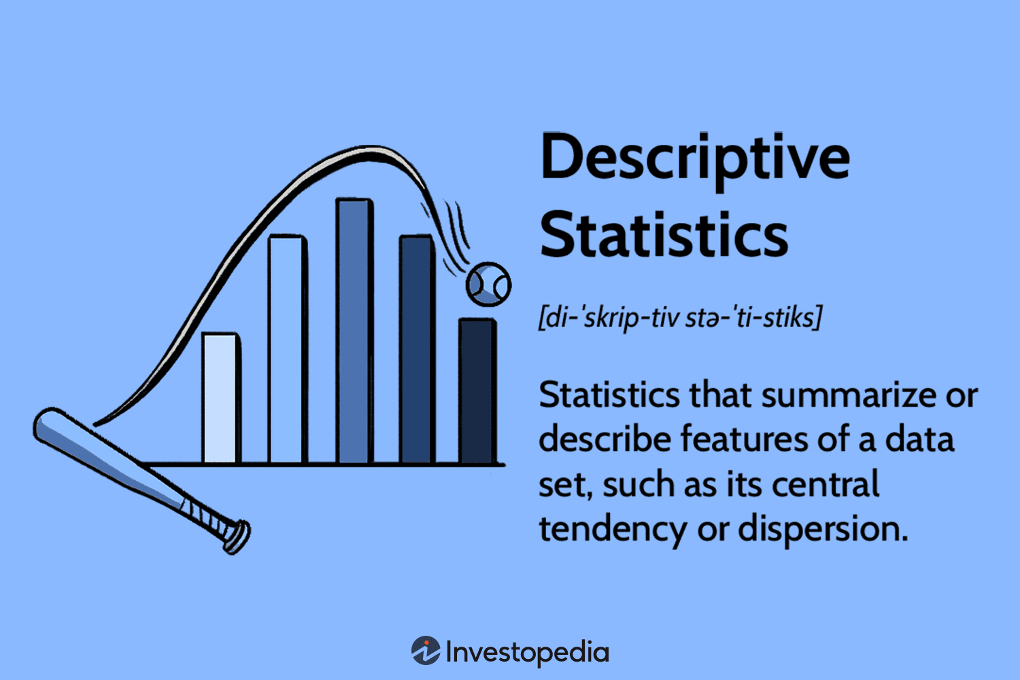
Measures of central tendency
MEAN
MEDIAN
Mean is the average of a data set. It gives us a sense of what value can be center value in the given data set (Investopedia, n.d.).
In our data set the value of the mean is 388,207,231.07. This is the average of earnings of all companies before subtracting interest, taxes, depreciation, and amortization.
The median is the center value of the data set. The median of our data is 211,566,000.
(Investopedia, n.d.)

Slide 8

MODE
DESCRIPTIVE ANALYSIS
Mode is the most occurring or repeated value in the data set.
As for EBITDA, the mode is 114,044,000. This means that EBITDA for most companies is 114,04,000.
(GoogleImages, n.d.)
CONCLUSION – We can say our data is positively or right skewed.
Mean> Median> Mode
For our data set, we can say it fulfills the rule 388,207,231.7 > 211,556,000 > 114,044,000.

Slide 9
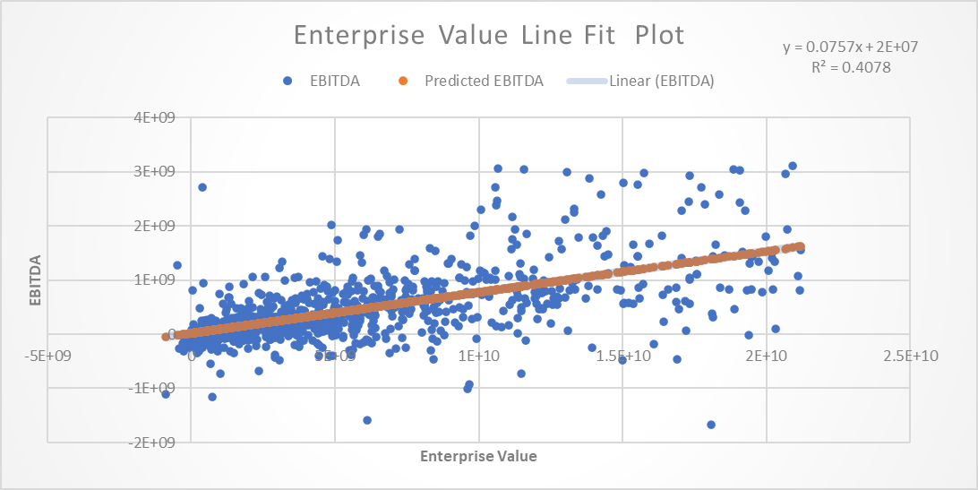
LINEAR REGRESSION
Earnings over enterprise value
Positive Correlation between variables
Moderately Strong correlation
Directly related variables

Slide 10
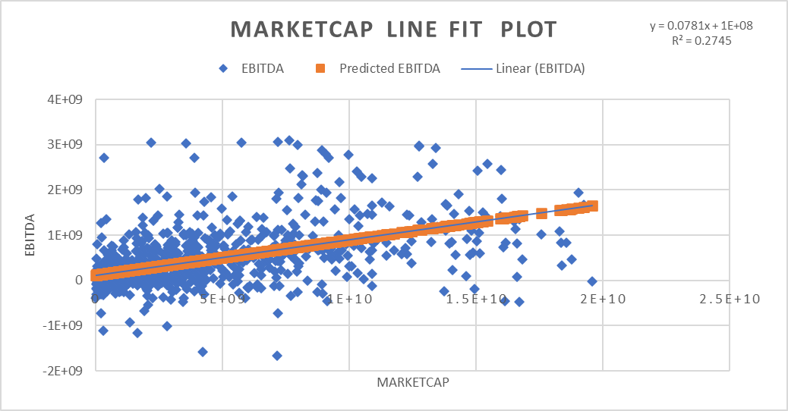
Earnings over market capitalization
Positive Correlation
Moderately Strong relationship
Directly related variables

Slide 11
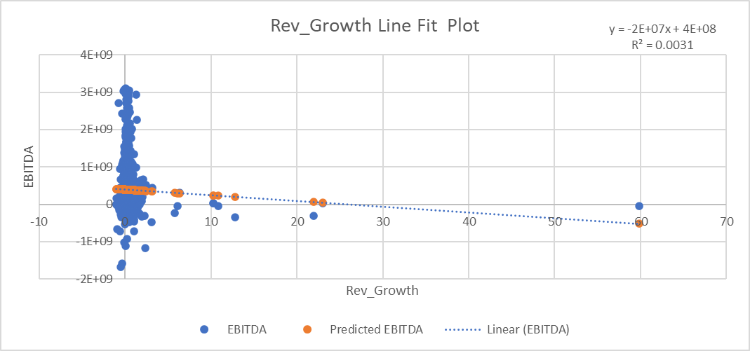
Earnings over revenue growth
Negative relationship
Very weak correlation
Inversely related variables

Slide 12
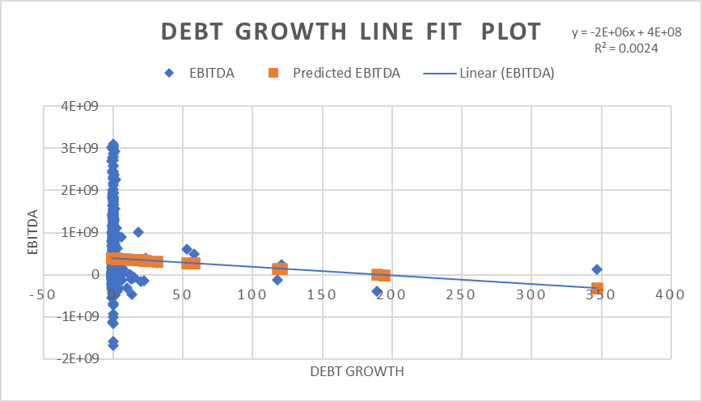
Earnings over debt growth
NEGATIVE RELATIONSHIP
EXTREMELY WEAK CORRELATION
INVERSELY related variables

Slide 13
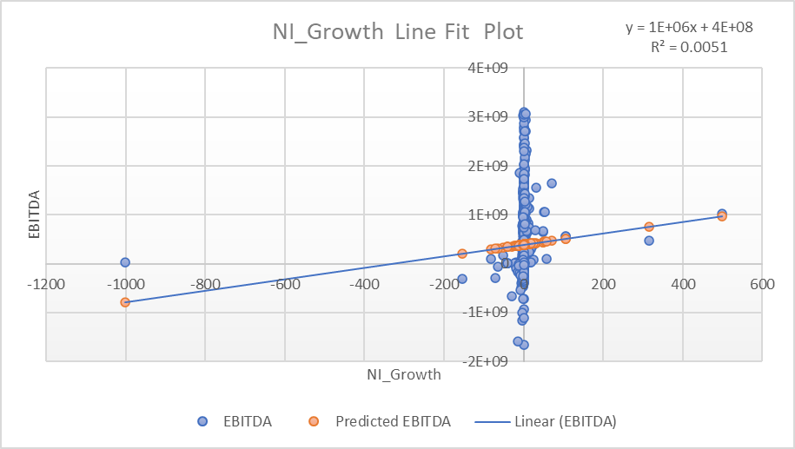
Earnings over Net income growth
Positive relationship
Negligible correlation
Directly related variables

Slide 14
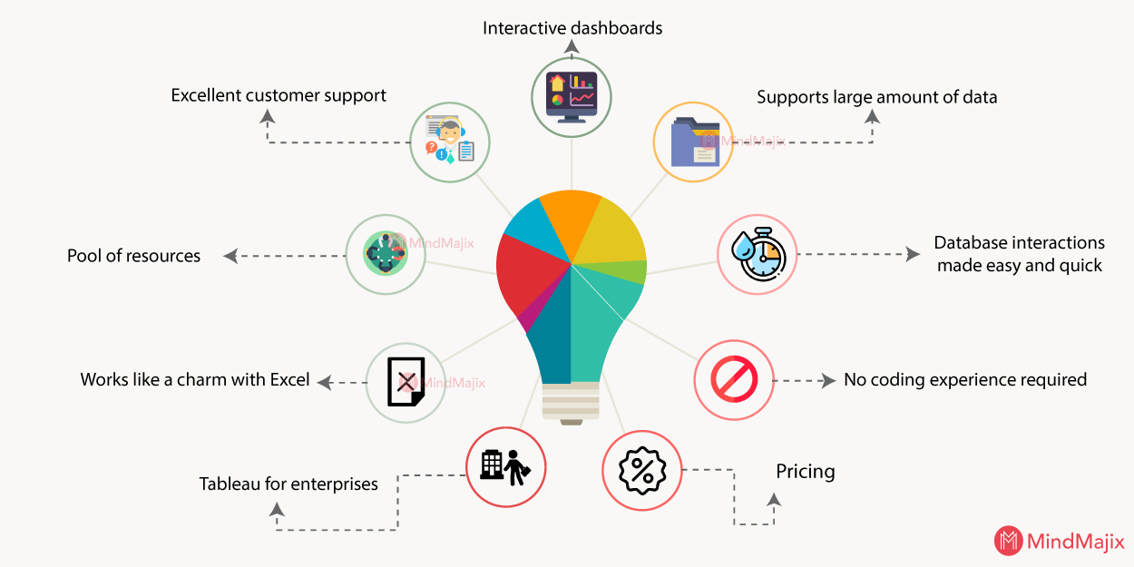

WHY TABLEAU ?
Notes:
Saikumar. (2021, April 22). Why Tableau is Considered the Best BI Tool ? Mindmajix; Mindmajix. https://mindmajix.com/tableau-best-bi-tool
‌
‌

Slide 15
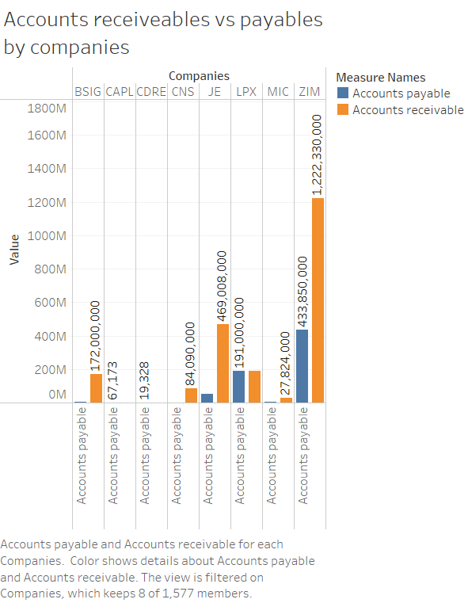
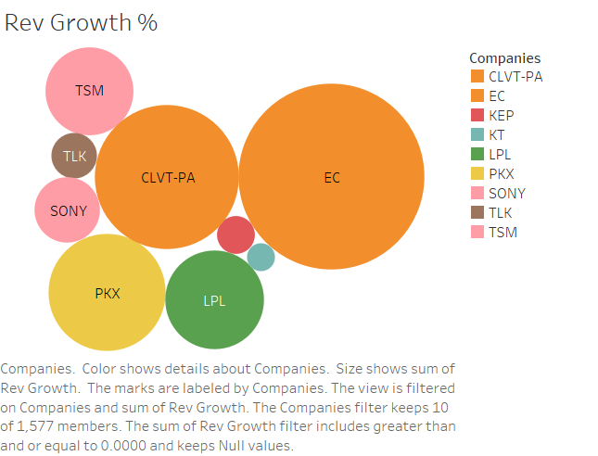
TABLEAU ANALYSIS
We can see the top 10 companies in the terms of Accounts Receivables. Account Receivables is shown with comparison of accounts payable .
ZIM is the company with highest account receivable and has the highest difference between receivables and payable.
These are the top 10 companies in comparison with the Revenue Growth %. These has the highest revenue growth out of 1577 companies.
EC, CLVT-PA . TSM and SONY are the topmost companies with 0.8%, 0.4%, 0.3% and 0.1% respectively.

Slide 16
PREDICTIVE ANALYSIS RESULTS
VARIABLE |  | Predicted value taken | Predicted EBITDA | MODEL 1 = RMSE | MODEL 2 = Logistic regression
X | Y
Enterprise Value | EBITDA | 500000000 | 1121153929.25542 | 94308935286976.10000 | 0.16456
Market Cap | EBITDA | 500000000 | 1121153929.25542 | 94326586938646.80000 | 0.16456
Rev_Growth | EBITDA | 0.555552888 | 1076582392.40443 | 2074091336610.39000 | 0.83544
NI_Growth | EBITDA | 2.555552888 | 1076582392.58272 | 2074091336610.38000 | 0.83544
Debt Growth | EBITDA | -1.555552888 | 1076582392.21624 | 2074091336610.39000 | 0.83228

Slide 17


SMOTE ANALYSIS
EBITDA
RATING
VS
Accuracy Test of Logistic Regression Model
46%

Slide 18


FRAUD VS. NOT FRAUD [COMPANIES]
PREDICTIVE ANALYSIS
M_SCORE
95%
FRAUD
NOT FRAUD
Linear Regression Model Accuracy

Slide 19
THANK YOU!

